Slide 1

E-Commerce Review Sentiment Analysis
Notes:
Hi everyone we are team 61 we are presenting e-commerce review sentiment analysis today

Slide 2
Table of contents
1
Motivation
4
modeling
30s
1.5m
2
Data understanding
5
implementation
1m
1,5m
3
Data preparation
6
Results, evaluation and deployment
1m
30s 30s

Slide 3

1. motivation

Slide 4

Enhancing e-commerce with review insights
E-commerce offers global reach and convenience, relying on internet transactions.
Customer reviews are pivotal in influencing online purchase decisions.
Analyzing customer feedback through data mining is key for strategic business decisions.
Project utilizes Kaggle’s Women's E-Commerce Clothing Reviews dataset for sentiment analysis.
LSTM model to predict sentiments; word clouds to identify common terms in negative feedback.
The goal is to pinpoint improvement areas to elevate customer satisfaction and ratings.

Slide 5
2. Data understanding

Slide 6
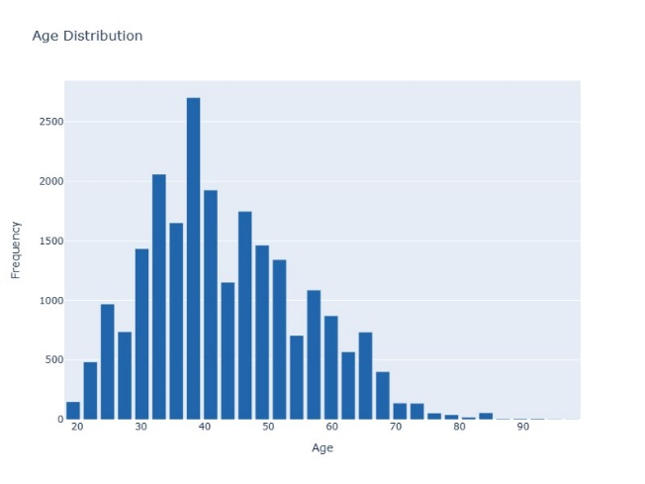
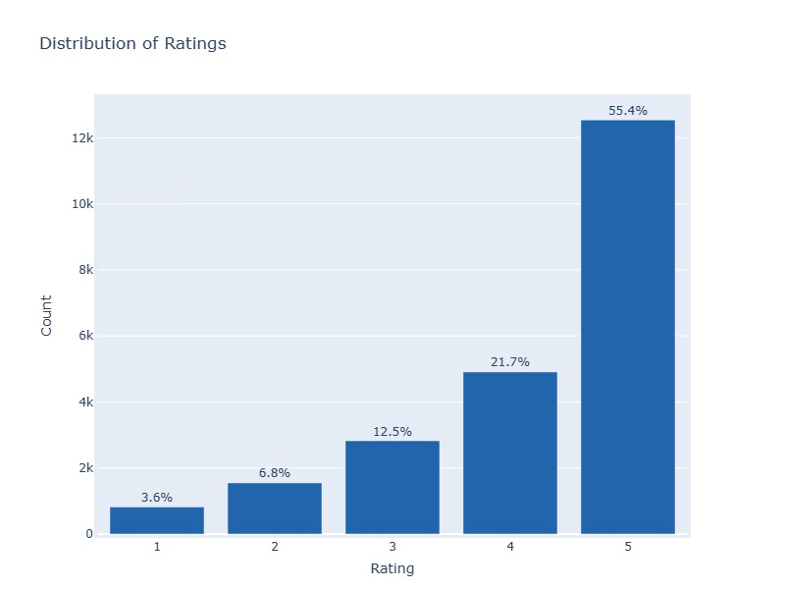
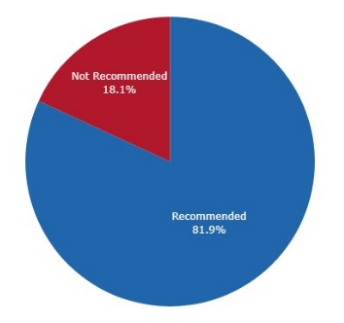
Understanding data
Analyzing Customer Sentiment
Analyzing Demographic Profile
Average rating of 4.2 signals positive feedback.
82% of reviews recommend the products.
Reviewer demographics show a diverse customer base.
Age of reviewers span from 18 to 99 years
Distribution of Ratings
Distribution of Recommendation
Distribution of Age

Slide 7
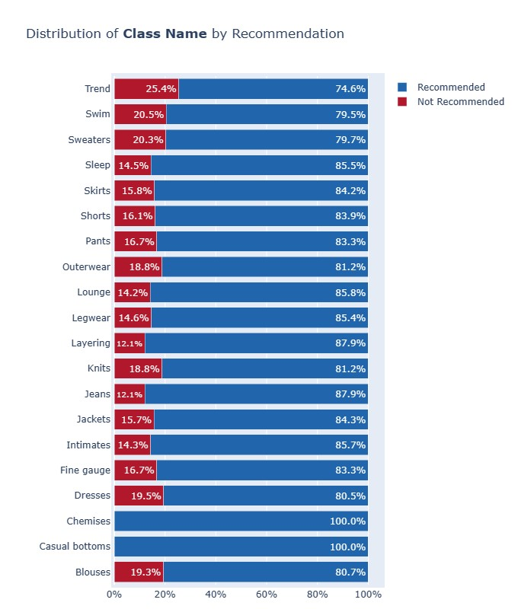
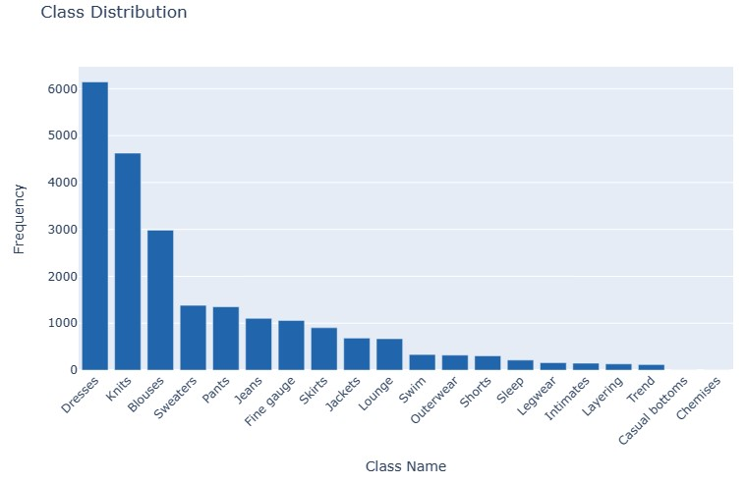
Analyzing classes
Majority of reviews are positive across all product classes.
'Chemises' and 'Casual bottoms' have 100% recommendation rates due to only one review.
'Dresses', 'Knits', and 'Blouses' receive the highest volume of reviews.

Slide 8
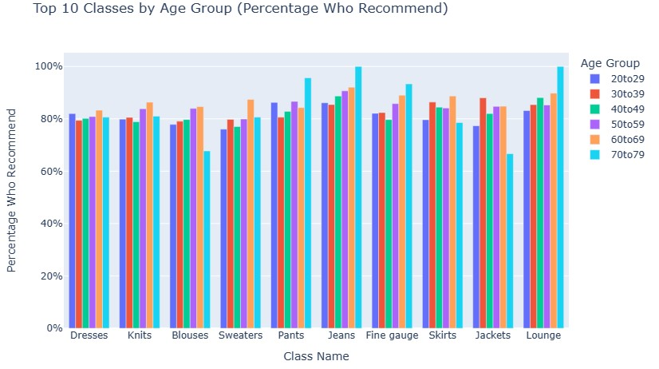
Analyzing age groups
Positive product reception is uniform across all age demographics.
20-29 and 30-39 age groups show similar recommendation patterns.
40-49 age group is more conservative in product endorsements.
50-59 age group favors recommending 'Dresses' and 'Jeans'.
'Fine Gauge' is particularly preferred by the 60-69 and 70-79 age groups.

Slide 9

3. data preparation

Slide 10
Data preparation process
Data Cleaning
Removing Duplicates: Remove 21 rows of duplicates to maintain the integrity of the dataset
Drop Null Values: Drop rows which has empty review text.
Add “Text Length” column: Add text length column as a reference for padding length
Text Tokenizing and Encoding
Tokenize each review sentence into word tokens. Remove punctuation and encode the word into integers by sorting word frequency
Turn sentences into word vectors.
Padding Sequence
Extend or cut sentences into specific lengths to deal with too short or long reviews. To ensure we have more standardized and consistent datasets to feed in deep learning networks.
Use 100 as our padding sequence length. As observed in the “text length” visualization, there is a surge in around 100 words.

Slide 11

4. Modeling

Slide 12
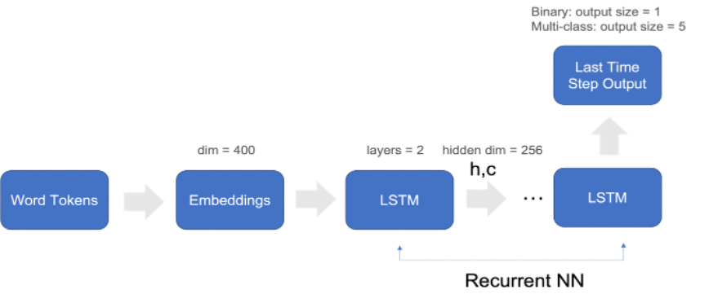
Model Architecture
Steps
Embed the text to condense it into lower dimensions
Add LSTM layers as RNN to memorize the long-term and short-term semantic of words.
Output the last time step output to predict the sentiment.
For Binary Classification
add another sigmoid layer
For Multi-Class Classification
Use linear layer output
Notes:
Model Architecture
In the data preparation phase, the text has already been converted into integers. Now, instead of considering the entire vocabulary size, we can embed the text to condense it into lower dimensions. After that, we add LSTM layers as RNN to memorize the long-term and short-term semantic of words. Finally, we output the last time step output to predict the sentiment. For binary classification, since the loss function is BCE, we need to add another sigmoid layer; whereas for multi-class classification we use linear layer output because the cross entropy loss itself includes the sigmoid transformation. Please refer to below graph for the process:

Slide 13
Hyperparameters
Embeddings, number of layers, hidden dimension and output size are the parameters used in the models
1. LSTM for Binary Classification
2. LSTM for Multi-Class Classification
Input: Review Text
Label: Recommend or Not (0 or 1)
Prediction Output: Sigmoid Probability between 0 and 1
Loss Function: Binary Cross Entropy Loss
Input: Review Text
Label: Rating (1 to 5)
Prediction Output: Linear Layer output, size =5
Loss Function: Cross Entropy Loss
Embeddings
Layers
Hidden Dim
Output Size
Embeddings
Layers
Hidden Dim
Output Size
400
2
256
1
400
2
256
5
Notes:
Hyperparameters
Embeddings, number of layers, hidden dimension and output size are the parameters used in the models:
Input: Review Text
Label: Recommend or Not (0 or 1)
Predicting Output: Sigmoid probability between 1 and 1
Loss Function: Binary Cross Entropy Loss
Input: Review Text
Label: Rating (1 to 5)
Output: Linear layer output, output size = 5
Loss Function: Cross Entropy Loss
Embeddings
Layers
Hidden Dim
Output Size
400
2
256
1

Slide 14

5. implementation

Slide 15
Implementation
Hyperparameters Tuning
Up-Sampling
Reducing embedding dimension from 400 to 100
Add L2 regularization
Reducing epochs as early stop
validation loss curve performs a better decreasing trend
Problem
handling the proportion of positive sentiment
Solution
Increasing the sample proportion of unrecommend reviews
Result
Recommend an unrecommend review is 54.4% to 45.6%, and
Testing accuracy for binary classification increased from 87% to 92%.
Notes:
Hyperparameters Tuning: One of the challenges we faced was model overfitting. We handled this issue by reducing embedding dimension from 400 to 100, add L2 regularization, and reducing epochs as early stop. After tuning, the validation loss curve performs a better decreasing trend.
Up-sampling: Another challenge that we encountered during modeling was handling the proportion of positive sentiment. As we see from the visualization, over 80% of the reviews recommended the items, the imbalanced distribution impacted the model's ability to learn from diverse data. To address the issue, we tackled it by increasing the sample proportion of unrecommend reviews. After up-sampling, the percentage of recommend an unrecommend review is 54.4% to 45.6%, and the testing accuracy for binary classification also increased from 87% to 92%.

Slide 16

6. Results and evaluation

Slide 17
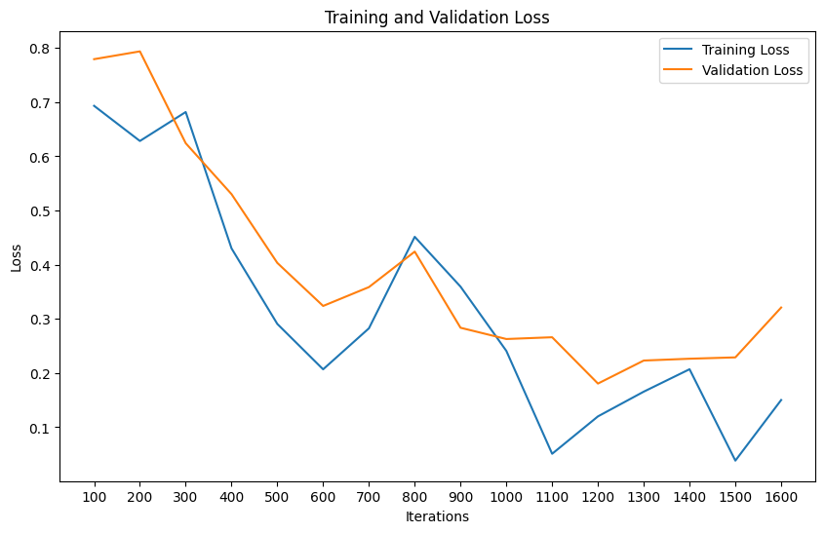
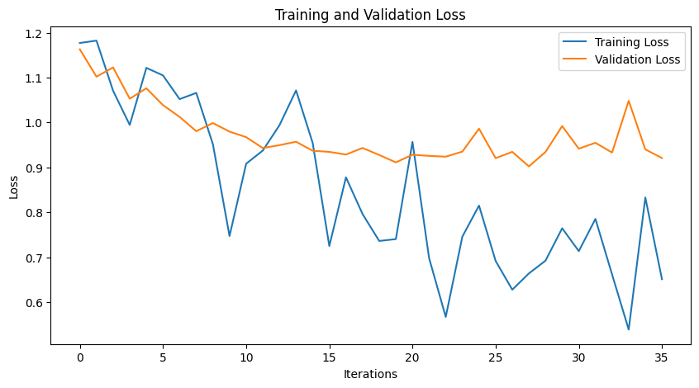
Results And evaluation
This analysis is a classification problem, so we use OOS Accuracy to evaluate the result. We use logistic regression as baseline model to see how the model performs. It is clear that the LSTM model more accurately identify whether customer recommend the item compared to classifying its rating.
LSTM for Binary Prediction
LSTM for Multi-Class Prediction
Test Loss: 0.163
Baseline Accuracy: 87%
Test Accuracy: 93%
Test Loss: 0.86
Baseline Accuracy: 55.43%
Test Accuracy: 61.7%
Notes:
LSTM for Binary Prediction
Test Loss: 0.163
Test Accuracy: 93
LSTM for Multi-Class Prediction
Test Loss: 0.860
Test Accuracy: 61.7%

Slide 18

Slide title 29
7. deployment

Slide 19
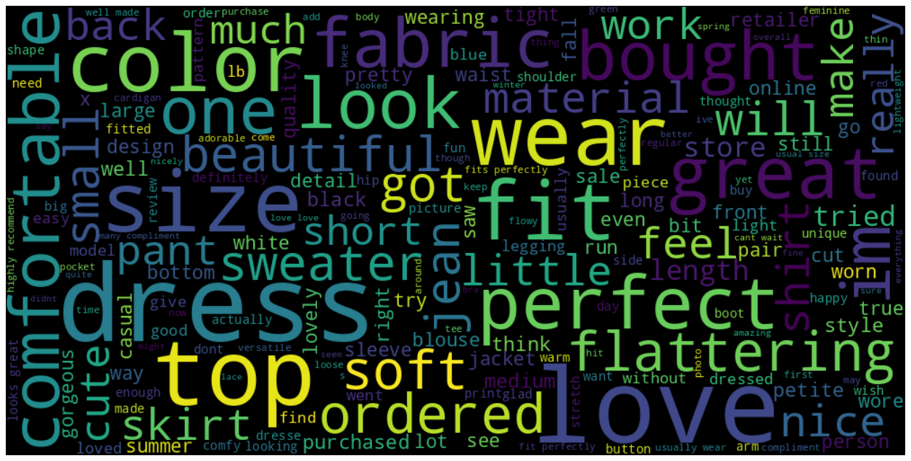
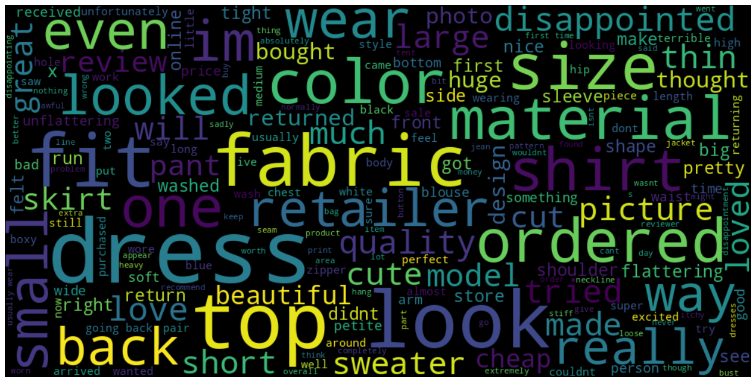
Insights from Analysis
Using Word Cloud
Word clouds analyze common terms in customer reviews, highlighting preferences.
Positive reviews frequently mention "Color", "Look", "Fit", "Dress", "Perfect", "Soft“, suggesting that customers particularly value the design and sizing of our clothing, especially our dresses.
Negative reviews often contain "Fabric", "Material", "Ordered", "Retailer", "Dress“, suggesting a need for improvement in product quality and after-sales service.
Age groups 40-49 and 50-59 show reservations, particularly about size and material.
Suggested refinement of the review system for more specific customer feedback.
Positive Word Cloud
Negative Word Cloud
Notes:
We can even set a particular age groups to see what they are interested in our product. We believe this will help e-commerce businesses to make their strategic decision.

Slide 20

Thank you

